Slide 1
PIZZA MANAGEMENT SYSTEM

Slide 2
EVERYONE IN TODAY’s World is Fond Of PIZZA
But the slow system of the software and different other websites irritates the individual. So we came up with this project of pizza management system where we made a pizza system to choose pizza according to size and the taste .

Slide 3
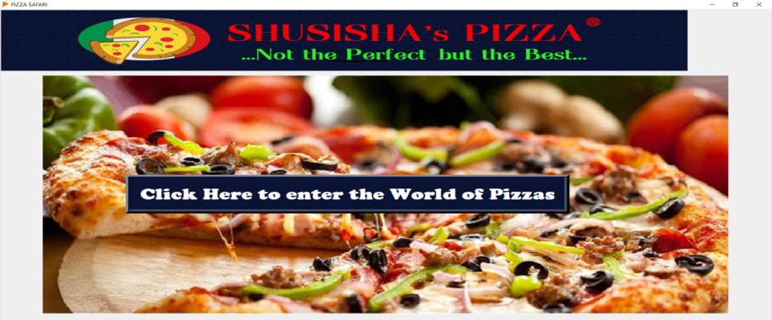
This is our Pizza outlet

Slide 4
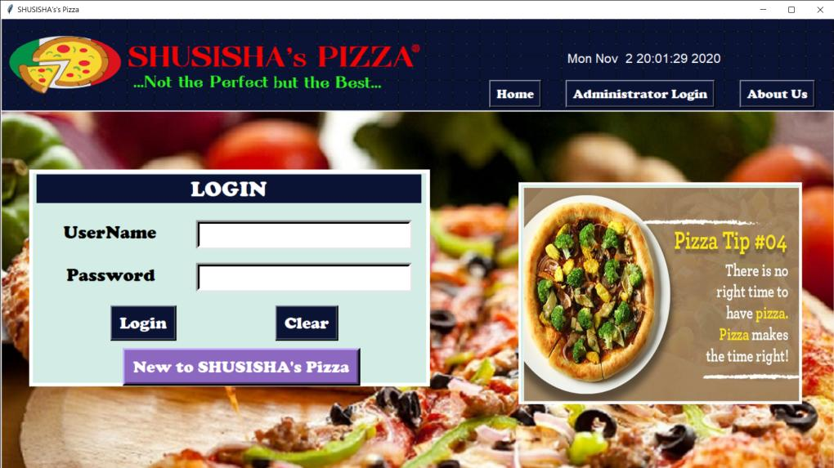
LOGIN PAGE (MAIN PAGE)

Slide 5
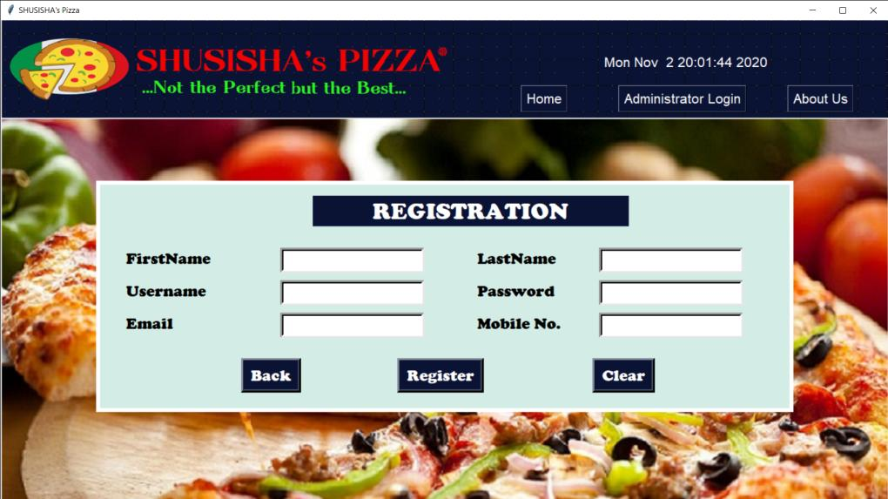
SIGN UP PAGE (MAIN PAGE-2)

Slide 6
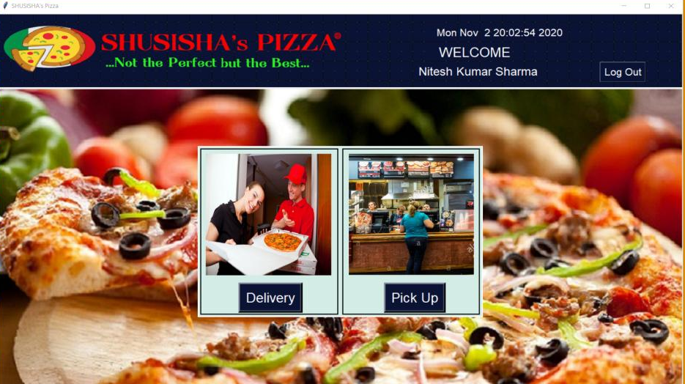
WELCOME PAGE (LOBBY)

Slide 7
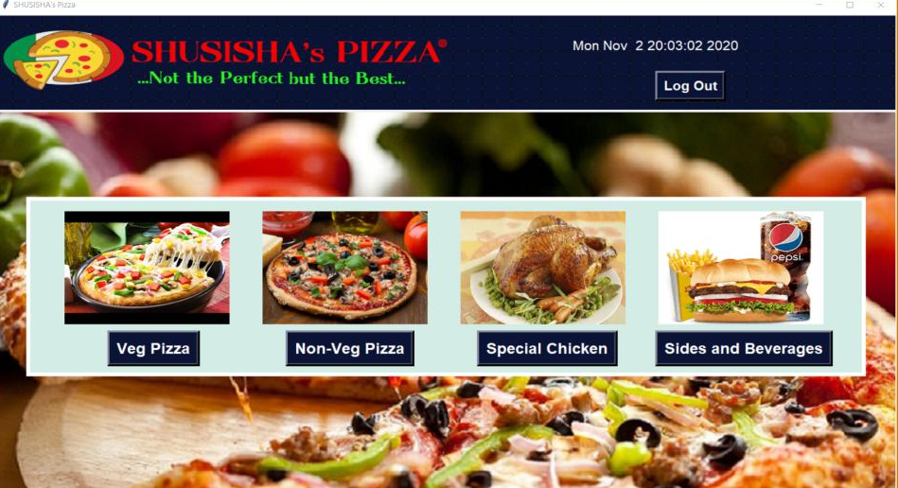
SELECTION PAGE (1)

Slide 8
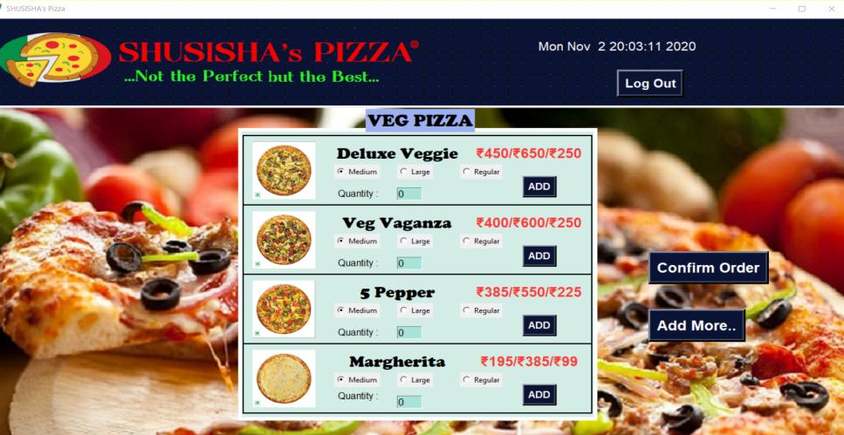
SELECTION PAGE (2)

Slide 9
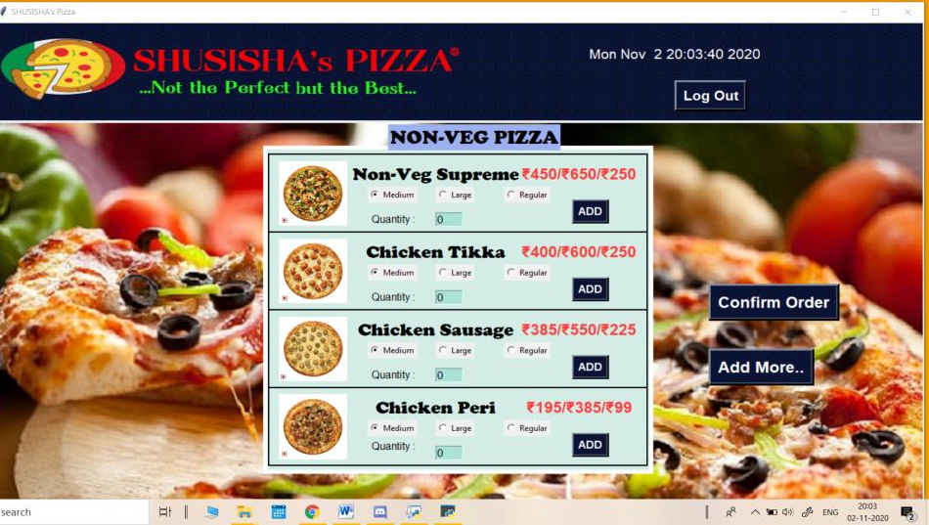
SELECTION PAGE (3)

Slide 10
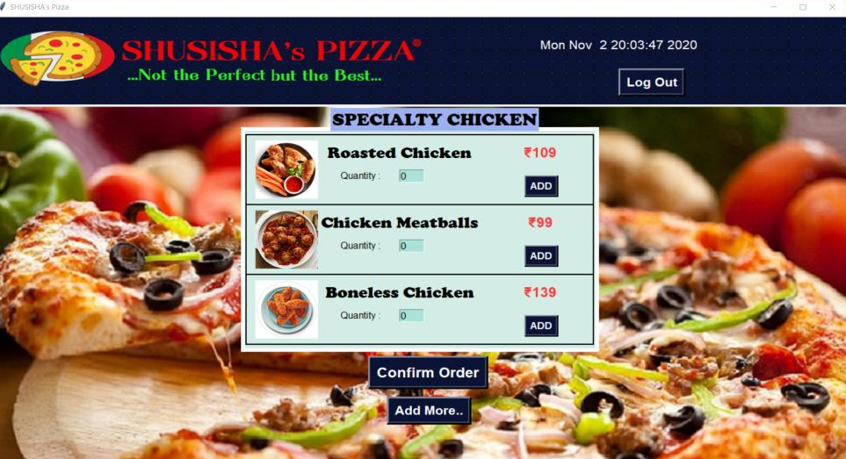
SELECTION PAGE (4)

Slide 11
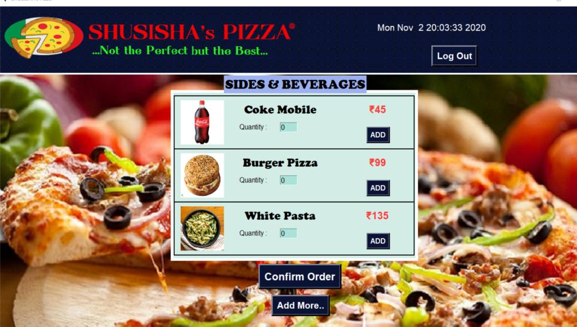
SELECTION PAGE (5)

Slide 12
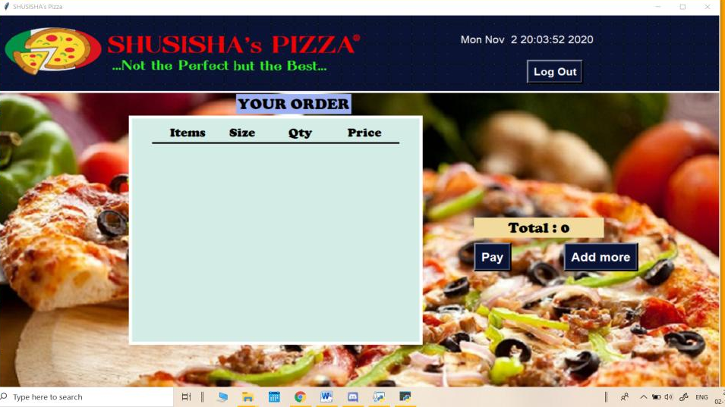
CONFIRMATION PAGE

